Slide 1



BIRLA VISHVAKARMA MAHAVIDYALAYA ENGINEERING COLLEGE
An Autonomous Institute
Vallabh Vidyanagar-388120
MINI PROJECT (3IT31)
GUIDED BY:
Prof. Karan Padhiyar

Slide 2


STOCK MARKET PREDICTION SYSTEM
Know what to add to your portfolio

Slide 3

OUR TEAM
Deep Hirapara
Vatsal Patel
Pratham Satani
21IT403
21IT414
21IT417

Slide 4

CONTENT
01
DATA ACQUISITION AND MANAGEMENT
02
PRICE PREDICTION MODULE
03
NEWS FEED MODULE
04
SENTIMENT ANALYSIS MODULE
05
TEST CASES

Slide 5

MODULES
DATA ACQUISITION AND MANAGEMENT MODULE
Aims:
Ensure data is captured without loss or corruption from various sources.
Implement error checking and validation mechanisms to maintain data integrity.
Clean, normalize and transform raw data into usable, structured format.

Slide 6
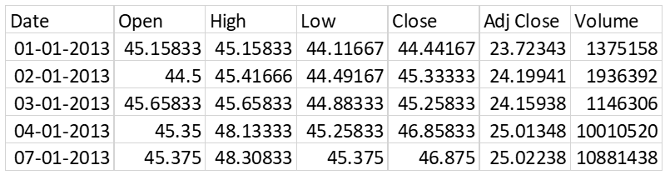
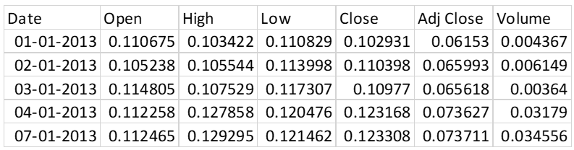
Data Acquisition and Management
DATASET:
DATA PREPROCESSING:

Slide 7

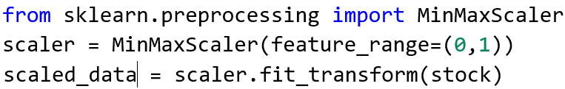
Data Acquisition and Management
DATASET:
Source: finance.yahoo.com
Format: CSV
Timeframe: 10 years
DATA ACQUISITION:
Using ‘yfinance’ module of python, the data would be downloaded.
DATA PREPROCESSING:
The values in the dataset are comparatively larger in magnitude than that accepted by the Machine Learning model. Thus we need to normalize it between [0, 1].

Slide 8
MODULES
2. PRICE PREDICTION MODULE
Aims:
Forecast the closing prices of selected stocks for a time horizon of up to two months.
Utilize Long Short-Term Memory (LSTM) networks to model the sequential nature of stock price data.
Specify the plotting approach used to compare actual stock prices with the model's predictions

Slide 9
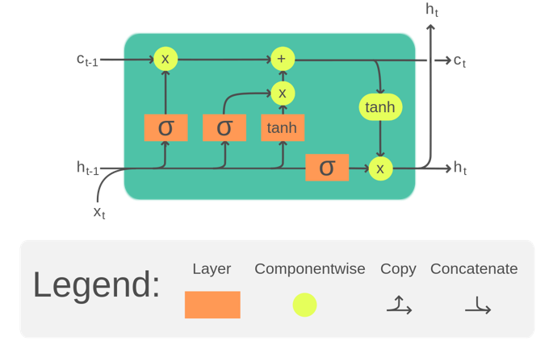
Price Prediction
METHODOLOGY:
Future prices for selected stocks will be predicted up to 2 months.
LSTM model (Long Short-Term Memory) will be used. Reason behind using LSTM is in time-series prediction, it has a higher memory power than RNNs.
ARCHITECTURE OF LSTM CELL

Slide 10
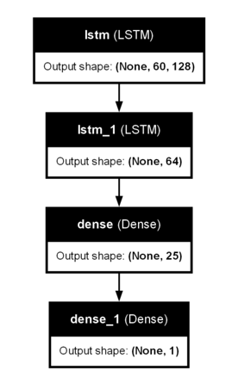
Price Prediction
ARCHITECTURE OF THE ACTUAL ML MODEL

Slide 11
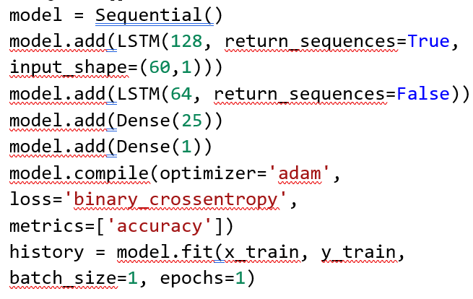
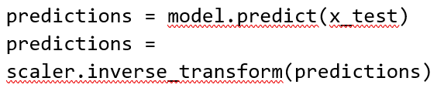
Price Prediction
MODEL CREATION AND TRAINING
PREDICTION USING TRAINED MODEL

Slide 12
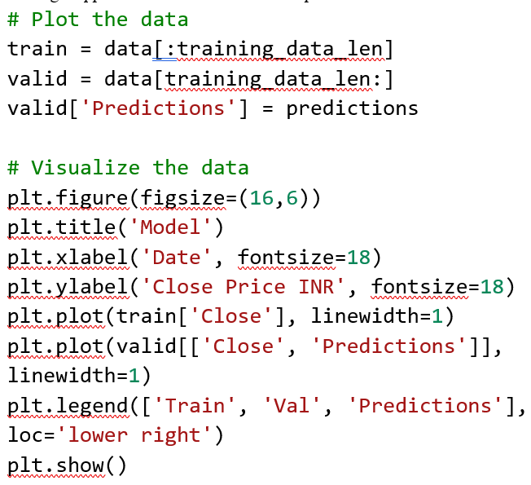
Price Prediction
PLOTTING THE RESULTS

Slide 13
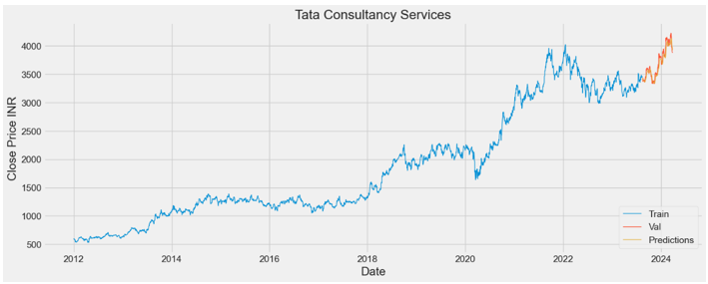
Price Prediction
2-MONTHS PREDICTION FOR TCS

Slide 14
MODULES
3. NEWS FEED MODULE
Aims:
Aggregate news headlines from several sources.
Provide the cleaned data to the Sentiment Analysis module.
Implement HTTP Response-Request to fetch data from open sources.

Slide 15
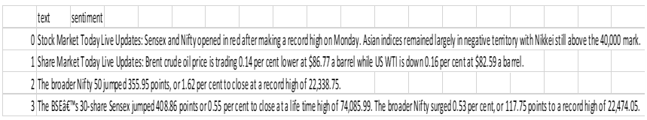
News Feed
METHODOLOGY:
The module is specifically designed to gather targeted news related to stock market movements. It filters news based on stock symbols and potentially regional preferences.
It forgoes the use of a dedicated news library like NewsApiClient and interacts directly with the MarketAux API using basic HTTP requests.
OUTCOME:
NEWS FETCHED FROM THE INTERNET USING NEWS FEED MODULE

Slide 16
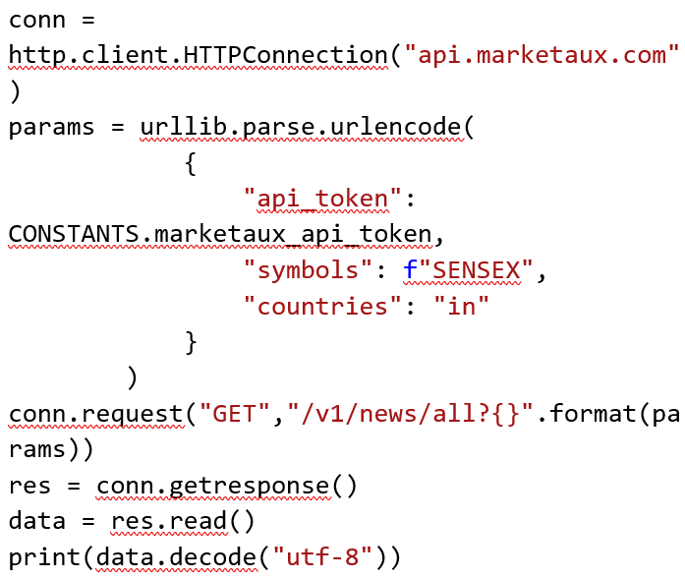
News Feed
SNIPPET DEMOSTRATING THE WORKING OF THIS MODULE

Slide 17
MODULES
4. SENTIMENT ANALYSIS MODULE
Aims:
To extract relevant sentiment indicators from various textual sources, quantifying and categorizing them to determine the overall market or public opinion about a specific stock or sector.
Develop or implement techniques to accurately detect positive, negative, and neutral sentiment within the gathered textual data.
Consider classifying sentiment into finer-grained emotions (e.g., fear, optimism, joy) for more nuanced analysis.

Slide 18
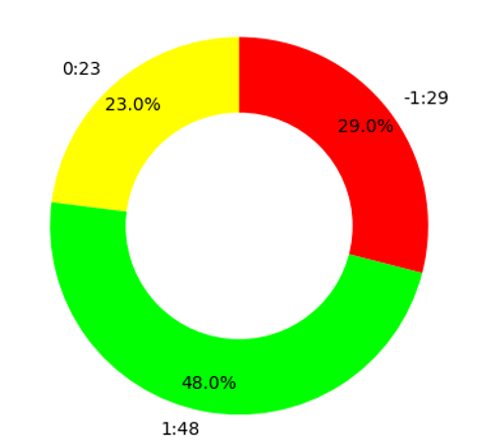
Sentiment Analysis
METHODOLOGY:
Combines a rule-based lexicon (the custom dictionary) with the machine-learning-trained VADER model for sentiment analysis.
Explicitly retrieves news related to stocks, making sentiment analysis more tailored to stock price prediction.
Provides simplified sentiment representation (positive, negative, neutral) for potential integration with a price prediction model.
OUTCOME:
OVERALL MARKET SENTIMENT;
GREEN: BULLISH, RED: BEARISH, YELLOW: NEUTRAL

Slide 19
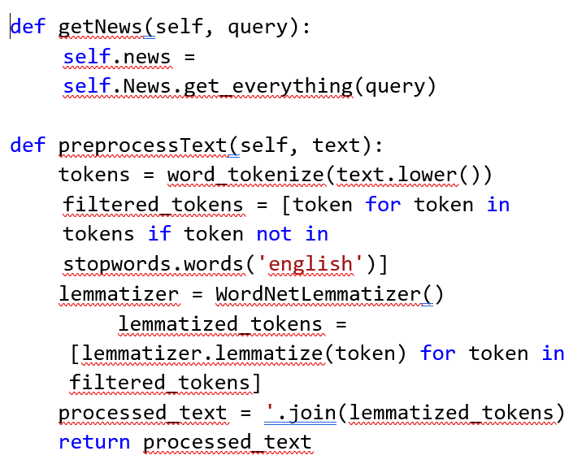
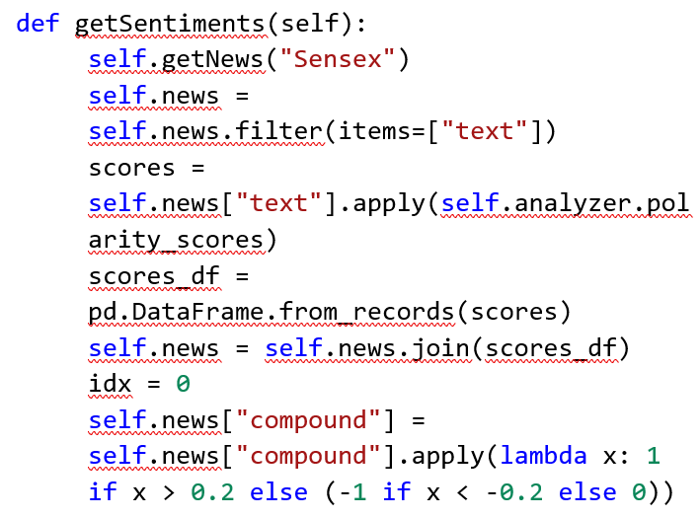
Sentiment Analysis
SNIPPET THAT SHOWS THE FUNCTIONING OF THIS MODULE

Slide 20
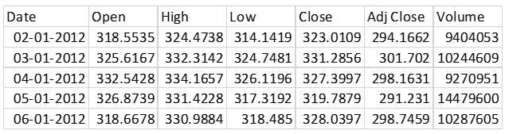
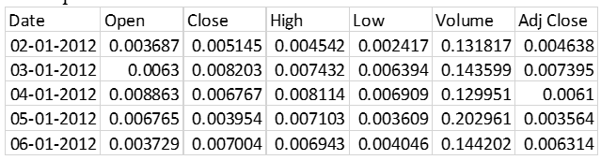
Test Case: RELIANCE
DATASET:
DATA PREPROCESSING:

Slide 21
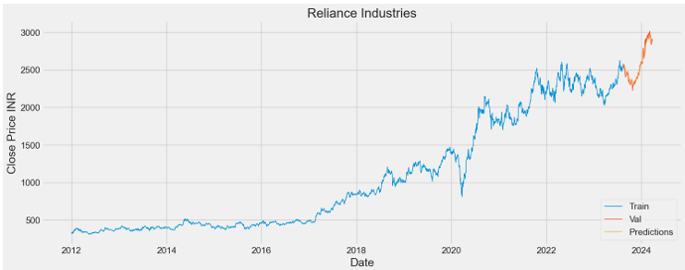
Test Case: RELIANCE
PRICE PREDICTION:

Slide 22

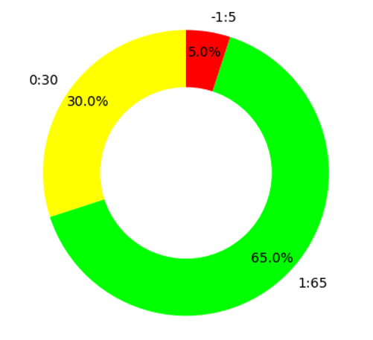
Test Case: RELIANCE
NEWS FEED:
SENTIMENT ANALYSIS:

Slide 23
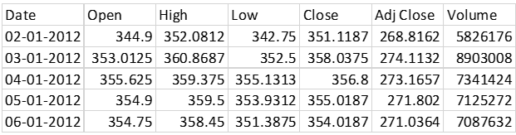
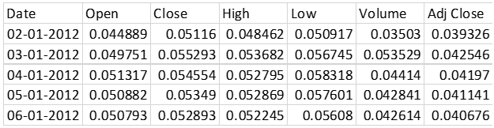
Test Case: INFOSYS
DATASET:
DATA PREPROCESSING:

Slide 24
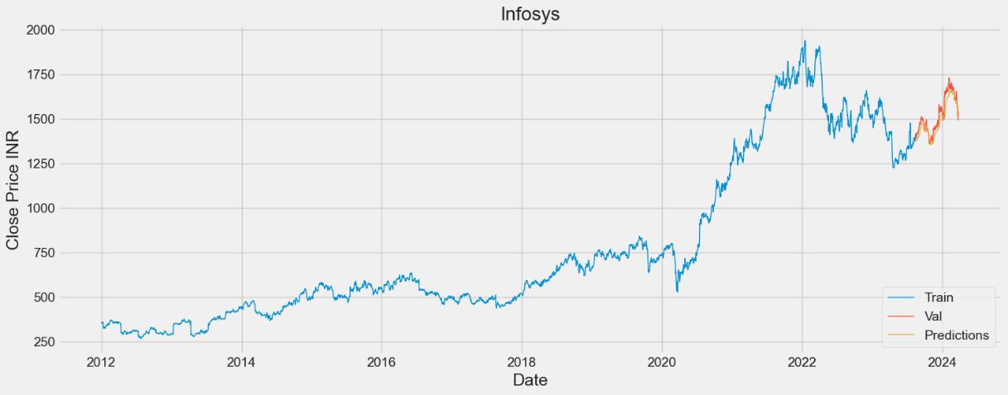
Test Case: INFOSYS
PRICE PREDICTION:

Slide 25
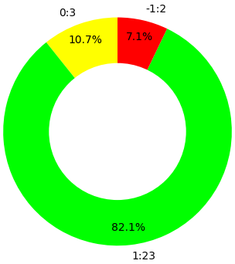
Test Case: RELIANCE
NEWS FEED:
SENTIMENT ANALYSIS:

Slide 26


THANK YOU FOR YOUR TIME!

